Slide 1
World of Fractions
By:Rawindhya Hettiarachchi
Fractions : LCM(least common multiple), numerator, denominator, addition, subtraction, multiplication and division

Slide 2
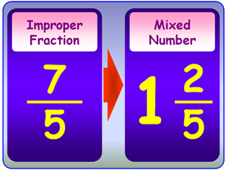
Improper to Mixed
If your answer’s numerator is bigger than its denominator than you have an improper fraction. If you get an improper fraction you need to convert it into a mixed number; a number that has a whole number and a fraction. The way you make a improper fraction into a mixed number is you have to divide the answer’s numerator by the denominator. If you have a remainder then that remainder will become the new numerator but you keep the same denominator. After you solve that you should have a whole number if you started with a improper fraction.

Slide 3
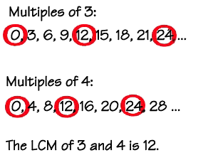
LCM
When starting to add fractions you find the LCM of the denominators; that is the denominator of the answer.

Slide 4
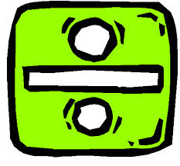
Division/Multiplication
If the denominators aren’t the same you divide the sum’s denominator by one of the factor’s denominator and then you multiply that quotient to the numerator of the fraction you used to get the quotient. Then you do the same thing to the other fraction(s).

Slide 5
Addition/Subtraction
After you get your new numerators you add or subtract depending on the problem you have. The answer you get after you add/subtract the factors numerators is the answer’s numerator.

Slide 6
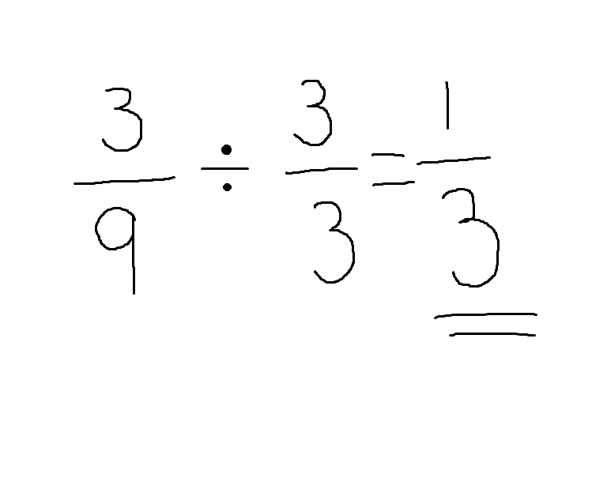
Equivalence
To make an equivalent fraction you can multiply or divide; to multiply a fraction you need one whole but written as a fraction like a fraction for example: 2/2 or 10/10 all you need to do is multiply both the numerator and the denominator by the same number. So technically all your doing is multiplying by 1.

Slide 7
Simplification
When you divide by a whole number (which is written as a fraction) it’s called simplifying. Simplified fractions are still equivalent to the fraction you started with. So basically you do the same steps that you do when you make a bigger fraction except you divide instead of multiplying.

Slide 8
Recourses
http://cf067b.medialib.glogster.com/media/94/94835b3ae00d2d84ddb9c2d91c73b0c17e7829ded90d8bb3fc6e9cb455fcb448/improper-fractions-and-mixed-numbers-jpg.jpg
http://www.math.com/school/subject1/images/SIU3L3GL.gif
http://static2.bigstockphoto.com/thumbs/0/7/7/large2/7701466.jpg

Slide 9
Credits
Caroline White
Ryann Smith
Luke Capello
Ms. Kilpatrick (teacher)

