Slide 1
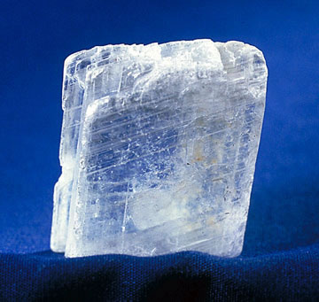
Gypsum
By Ben Rosenfeld and Pranav Kartha

Slide 2
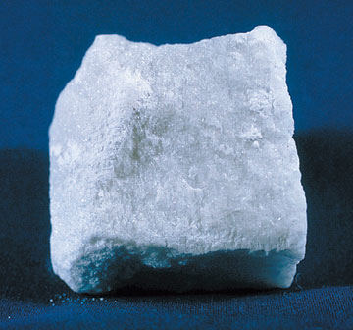
What is Gypsum?
Gypsum is a mineral commonly found in sedimentary deposits.
It is a lot like Halite, Sulfur, Anhydrite, Calcite, and Dolomite.

Slide 3
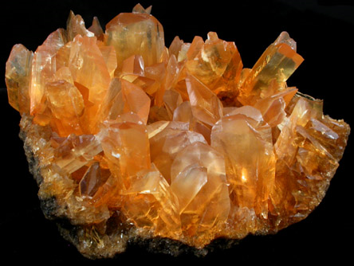
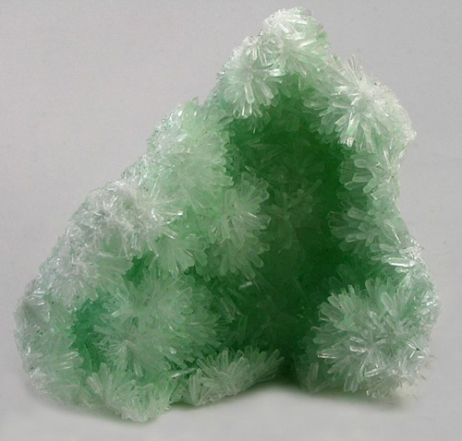
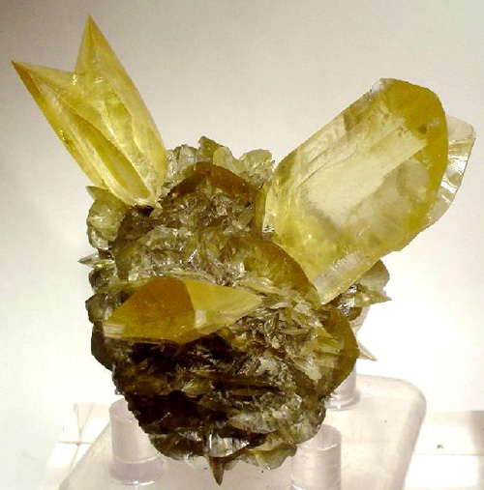
Color
Gypsum can be many different colors such as green, yellow, orange, clear, white, gray, red, and brown.

Slide 4
Streak
Gypsum has a white streak (That is the color that comes off the mineral when it is scraped on a surface.)

Slide 5
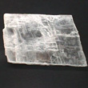
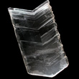
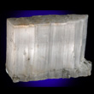
Luster
Gypsum can have a silky, sugary or glassy luster (That is how the mineral looks when it reflects light.)

Slide 6
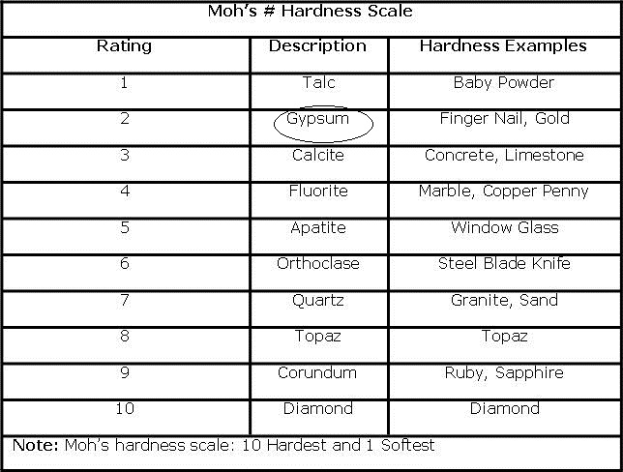
Hardness
Gypsum is a 2 on the Moh’s scale of hardness (That is a scale that measures how much the mineral can resist scratching.)
Two softer minerals are Graphite and Talc.
Two harder minerals are Calcite and Diamond.

Slide 7
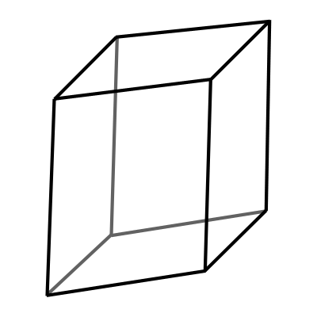
Crystal shape
Gypsum has a Monoclinic crystal shape.

Slide 8
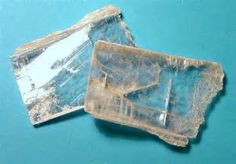
Cleavage and Fracture
Gypsum has perfect cleavage (That is how straight the line will be when it is cut.)

Slide 9
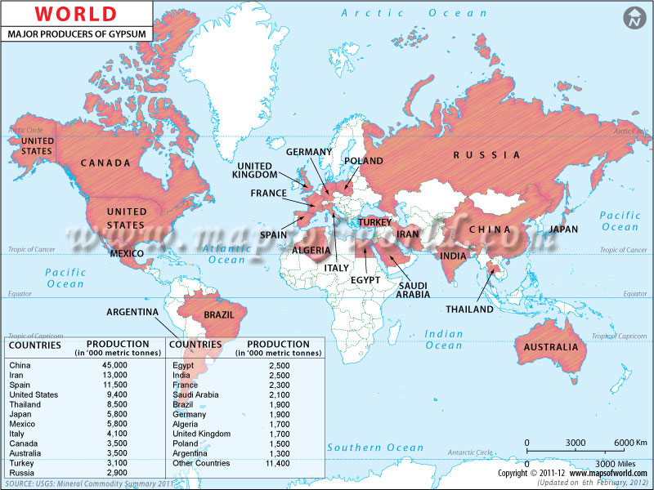
Where is it found?
Gypsum is found almost all over the world in layered sedimentary deposits.

Slide 10
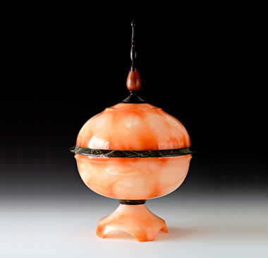
Fun Facts
Gypsum is used in Wallboard, Cement and plaster of Paris
Its chemical composition is CaSO42H2O.(Hydrous Calcium Sulfate.)
Gypsum can be made into beautiful Jars.

Slide 11
Resources
http://www.silverstreamsgardens.com/library/images/monoclinic.png
http://keepingfloorsclean.com/wp-content/uploads/2010/12/Mohs-Hardness-Scale.jpg
http://www.skywalker.cochise.edu/wellerr/mineral/gypsum/6selenite-cleavage10.jpg
http://www.mapsofworld.com/minerals/maps/world-gypsum-producers.jpg
http://minerals.net
http://geology.com

